Slide 1
Tool development to identification of conserved regulatory regions
Cristian Jesus Gonzalez Colin
Aldo
PhD Alejandra Medina

Slide 2
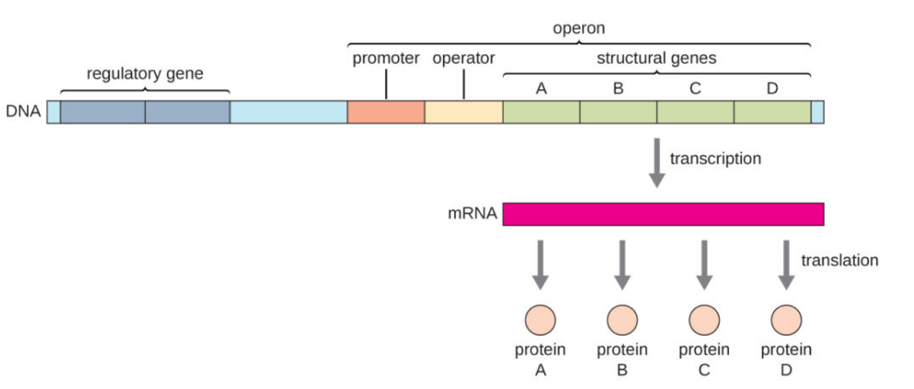
Gene Regulation Prokaryotes

Slide 3
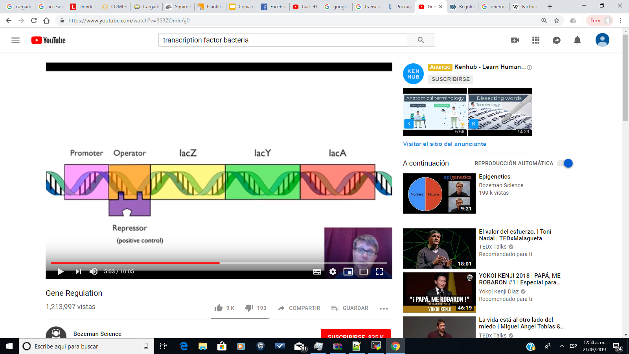
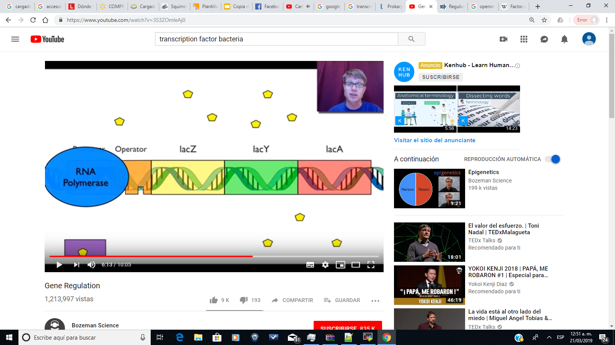
Gene Regulation Prokaryotes
Lac Operon

Slide 4
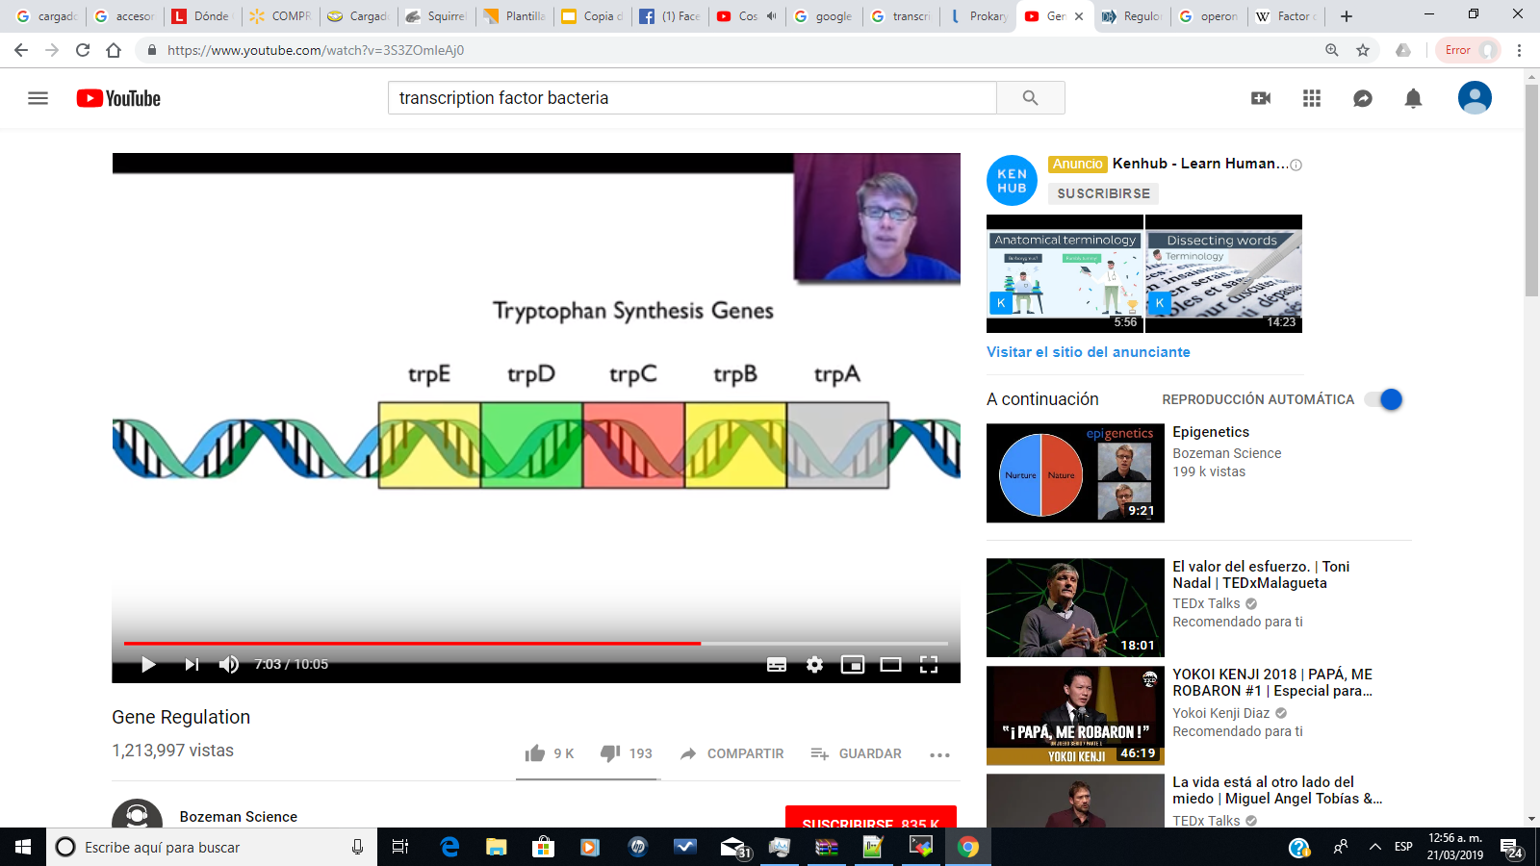
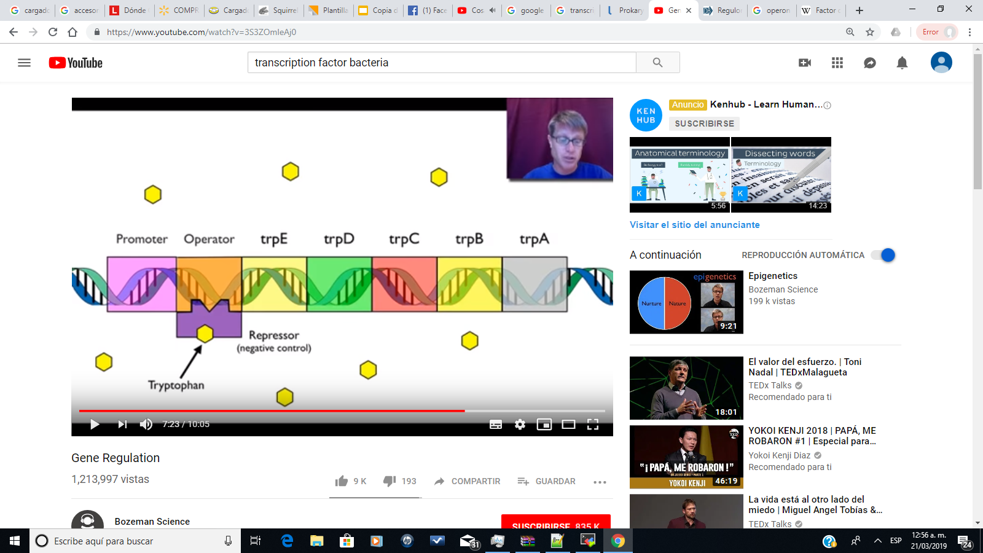
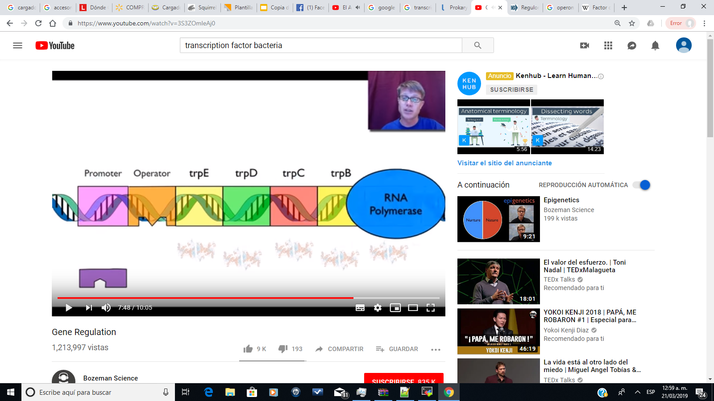
Gene Regulation Prokaryotes
Trp Operon

Slide 5
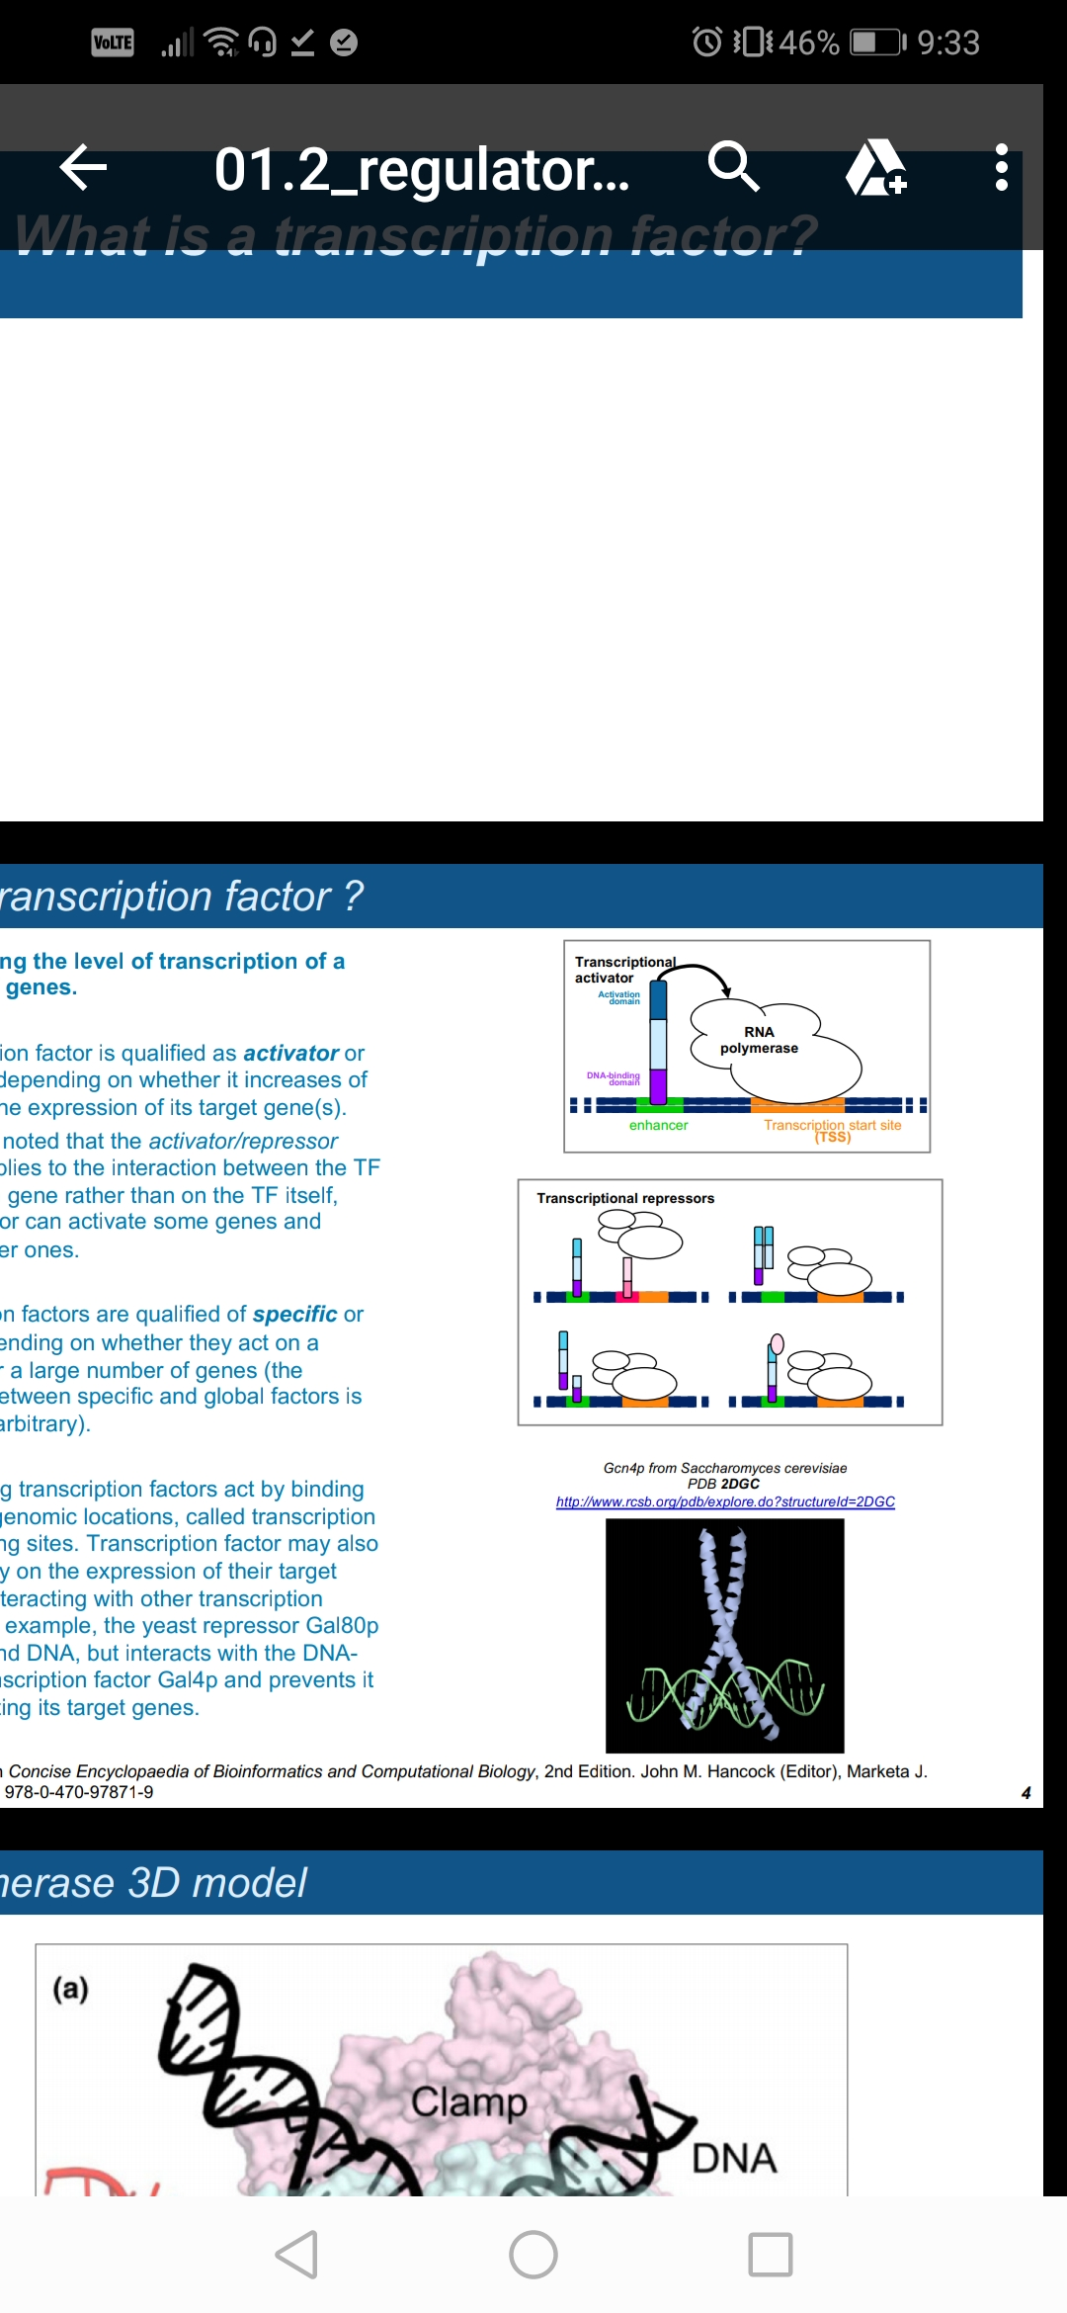
Gene Regulation Eukaryotes
Activity
Activator
Repressor
Specificity
Global
Specific
Mechanisms
Notes:
So, we can interpretate that TF is a protein that binds to specific DNA seq interacting with a ligand and start or suspend the transcription of a target gene.. This regulates gene expression.

Slide 6
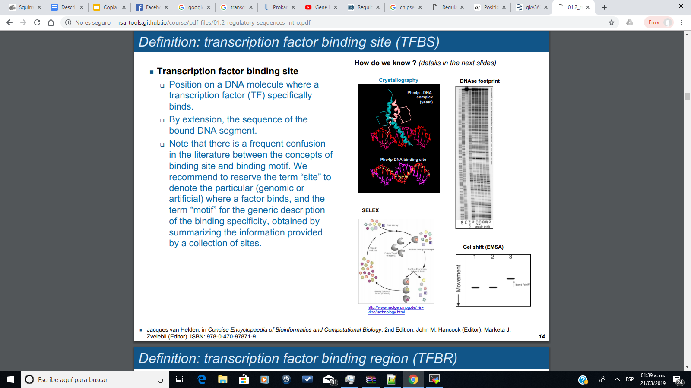
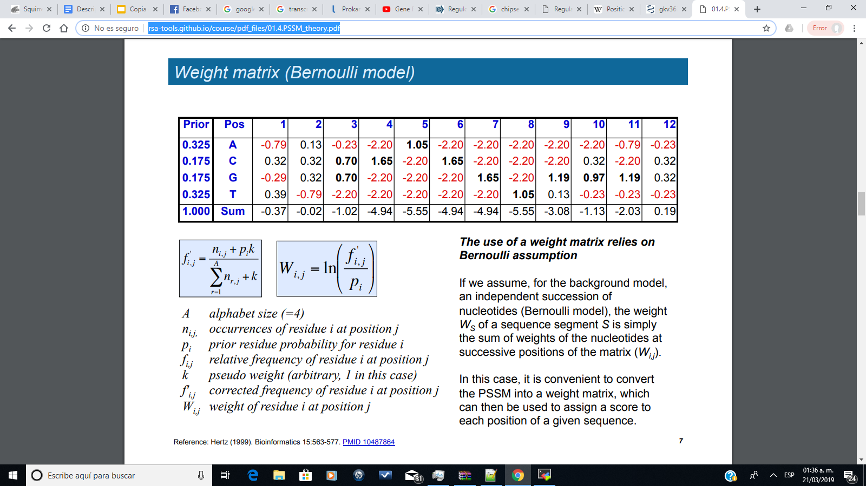
Identifying TF Binding Site
Wet lab approach
Dry lab approach
Notes:
This will help us to better understand the transcriptional regulation in the cell.

Slide 7
Bioinformatics programs
Monkey
Phyloscan
PhastCons
MotifMap
NotEvo
footprint-scan*

Slide 8
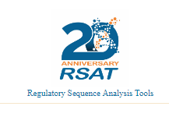
Bioinformatics programs
Monkey
Phyloscan
PhastCons
MotifMap
NotEvo
footprint-scan*

Slide 9
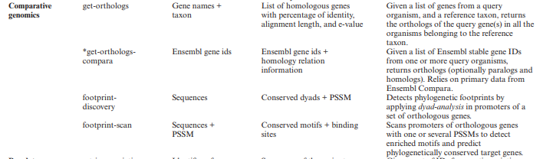
footprint-scan

Slide 10
Objective
Improve the detection accuracy of motif sites with footprint-scan

Slide 11
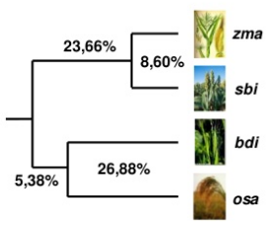
Improve footprint-scan
There are several cases when integrating phylogenetic trees improves sensitive and lowers FPR. (e.g. Bayesian Branch Length Score)

Slide 12
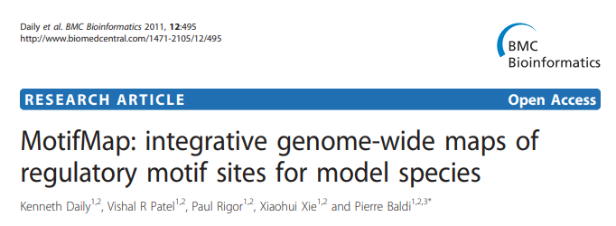
BBLS
BBLS = ∑ riBLS(σi)
Donde:
Ri = p1 if σi = 1
1 - p1 if σi = 0

Slide 13
Project goals
Implement the Bayesian Branch Length Score as a function in footprint-scan.
Securing a list of non-redundant genomes in the RSAT server.
Run this version of footprint-scan in the regulatory sequences of the E. coli genome.
Benchmark the obtained interactions by comparing it to the regulatory network reported in RegulonDB.

Slide 14
Results
Implement the Bayesian Branch Length Score as a function in footprint-scan.✔
(https://github.com/ahcorcha/bbls/blob/master/bbls.py)
Securing a list of non-redundant genomes in the RSAT server.✔
Run this version of footprint-scan in the regulatory sequences of the E. coli genome. ON GOING
Benchmark the obtained interactions by comparing it to the regulatory network reported in RegulonDB. TO DO

Slide 15
References

Slide 16
INSTRUCTIONS FOR USE
EDIT IN GOOGLE SLIDES
Click on the button under the presentation preview that says "Use as Google Slides Theme".
You will get a copy of this document on your Google Drive and will be able to edit, add or delete slides.
You have to be signed in to your Google account.
EDIT IN POWERPOINT®
Click on the button under the presentation preview that says "Download as PowerPoint template". You will get a .pptx file that you can edit in PowerPoint.
Remember to download and install the fonts used in this presentation (you’ll find the links to the font files needed in the Presentation design slide)
More info on how to use this template at www.slidescarnival.com/help-use-presentation-template
This template is free to use under Creative Commons Attribution license. You can keep the Credits slide or mention SlidesCarnival and other resources used in a slide footer.

Slide 17

HELLO!
I am Jayden Smith
I am here because I love to give presentations.
You can find me at @username

Slide 18
1.
TRANSITION HEADLINE
Let’s start with the first set of slides

Slide 19
Quotations are commonly printed as a means of inspiration and to invoke philosophical thoughts from the reader.

Slide 20
THIS IS A SLIDE TITLE
Here you have a list of items
And some text
But remember not to overload your slides with content
Your audience will listen to you or read the content, but won’t do both.

Slide 21
BIG CONCEPT
Bring the attention of your audience over a key concept using icons or illustrations

Slide 22
YOU CAN ALSO SPLIT YOUR CONTENT
White
Is the color of milk and fresh snow, the color produced by the combination of all the colors of the visible spectrum.
Black
Is the color of coal, ebony, and of outer space. It is the darkest color, the result of the absence of or complete absorption of light.

Slide 23
IN TWO OR THREE COLUMNS
Yellow
Is the color of gold, butter and ripe lemons. In the spectrum of visible light, yellow is found between green and orange.
Blue
Is the colour of the clear sky and the deep sea. It is located between violet and green on the optical spectrum.
Red
Is the color of blood, and because of this it has historically been associated with sacrifice, danger and courage.

Slide 24

A PICTURE IS WORTH A THOUSAND WORDS
A complex idea can be conveyed with just a single still image, namely making it possible to absorb large amounts of data quickly.

Slide 25

Want big impact?
Use big image.

Slide 26
USE CHARTS TO EXPLAIN YOUR IDEAS
White
Gray
Black

Slide 27
AND TABLES TO COMPARE DATA
 | A | B | C
Yellow | 10 | 20 | 7
Blue | 30 | 15 | 10
Orange | 5 | 24 | 16

Slide 28
MAPS
our office

Slide 29
89,526,124
Whoa! That’s a big number, aren’t you proud?

Slide 30
89,526,124$
185,244 users
100%
That’s a lot of money
And a lot of users
Total success!

Slide 31
OUR PROCESS IS EASY
first
second
last

Slide 32
LET’S REVIEW SOME CONCEPTS
Yellow
Is the color of gold, butter and ripe lemons. In the spectrum of visible light, yellow is found between green and orange.
Blue
Is the colour of the clear sky and the deep sea. It is located between violet and green on the optical spectrum.
Red
Is the color of blood, and because of this it has historically been associated with sacrifice, danger and courage.
Yellow
Is the color of gold, butter and ripe lemons. In the spectrum of visible light, yellow is found between green and orange.
Blue
Is the colour of the clear sky and the deep sea. It is located between violet and green on the optical spectrum.
Red
Is the color of blood, and because of this it has historically been associated with sacrifice, danger and courage.

Slide 33
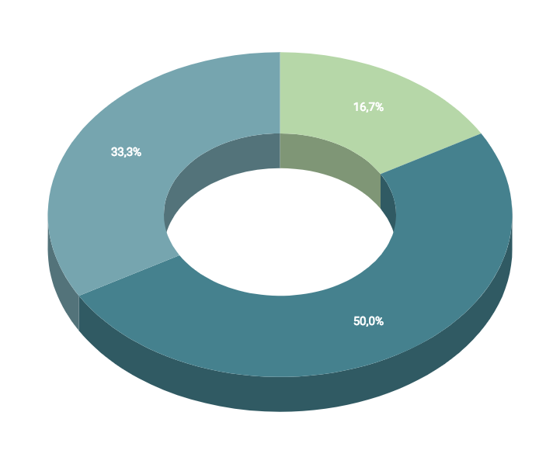
You can insert graphs from Google Sheets

Slide 34
ANDROID PROJECT
Show and explain your web, app or software projects using these gadget templates.
Place your screenshot here

Slide 35
iPHONE PROJECT
Show and explain your web, app or software projects using these gadget templates.
Place your screenshot here

Slide 36
TABLET PROJECT
Show and explain your web, app or software projects using these gadget templates.
Place your screenshot here

Slide 37
DESKTOP PROJECT
Show and explain your web, app or software projects using these gadget templates.
Place your screenshot here

Slide 38
THANKS!
Any questions?
You can find me at:
@username
user@mail.me

Slide 39
CREDITS
Special thanks to all the people who made and released these awesome resources for free:
Presentation template by SlidesCarnival
Photographs by Unsplash

Slide 40
PRESENTATION DESIGN
This presentation uses the following typographies and colors:
Titles: Dosis
Body copy: Titillium Web
You can download the fonts on these pages:
http://www.impallari.com/dosis
http://www.campivisivi.net/titillium/
Pastel green #d3ebd5 · Green #80bfb7 · Teal #0b87a1 · Navy #01597f · Dark navy #003b55
You don’t need to keep this slide in your presentation. It’s only here to serve you as a design guide if you need to create new slides or download the fonts to edit the presentation in PowerPoint®

Slide 41
SlidesCarnival icons are editable shapes.
This means that you can:
Resize them without losing quality.
Change fill color and opacity.
Change line color, width and style.
Isn’t that nice? :)
Examples:

Slide 42
😉
Now you can use any emoji as an icon!
And of course it resizes without losing quality and you can change the color.
How? Follow Google instructions https://twitter.com/googledocs/status/730087240156643328
✋👆👉👍👤👦👧👨👩👪💃🏃💑❤😂😉😋😒😭👶😸🐟🍒🍔💣📌📖🔨🎃🎈🎨🏈🏰🌏🔌🔑 and many more...

